Slide 1
INCLUSIVE EDUCATION POLICIES AND PROGRAMMES IN INDIAN CONTEXT
Dr. N.Johnson PhD.,NET(Edn).,NET-Andragogy
Assistant Professor
Department of Lifelong Learning
School of Education
Alagappa University
Karaikudi – 630 003
Tamil Nadu
johnsonn@alagappauniversity.ac.in

Slide 2
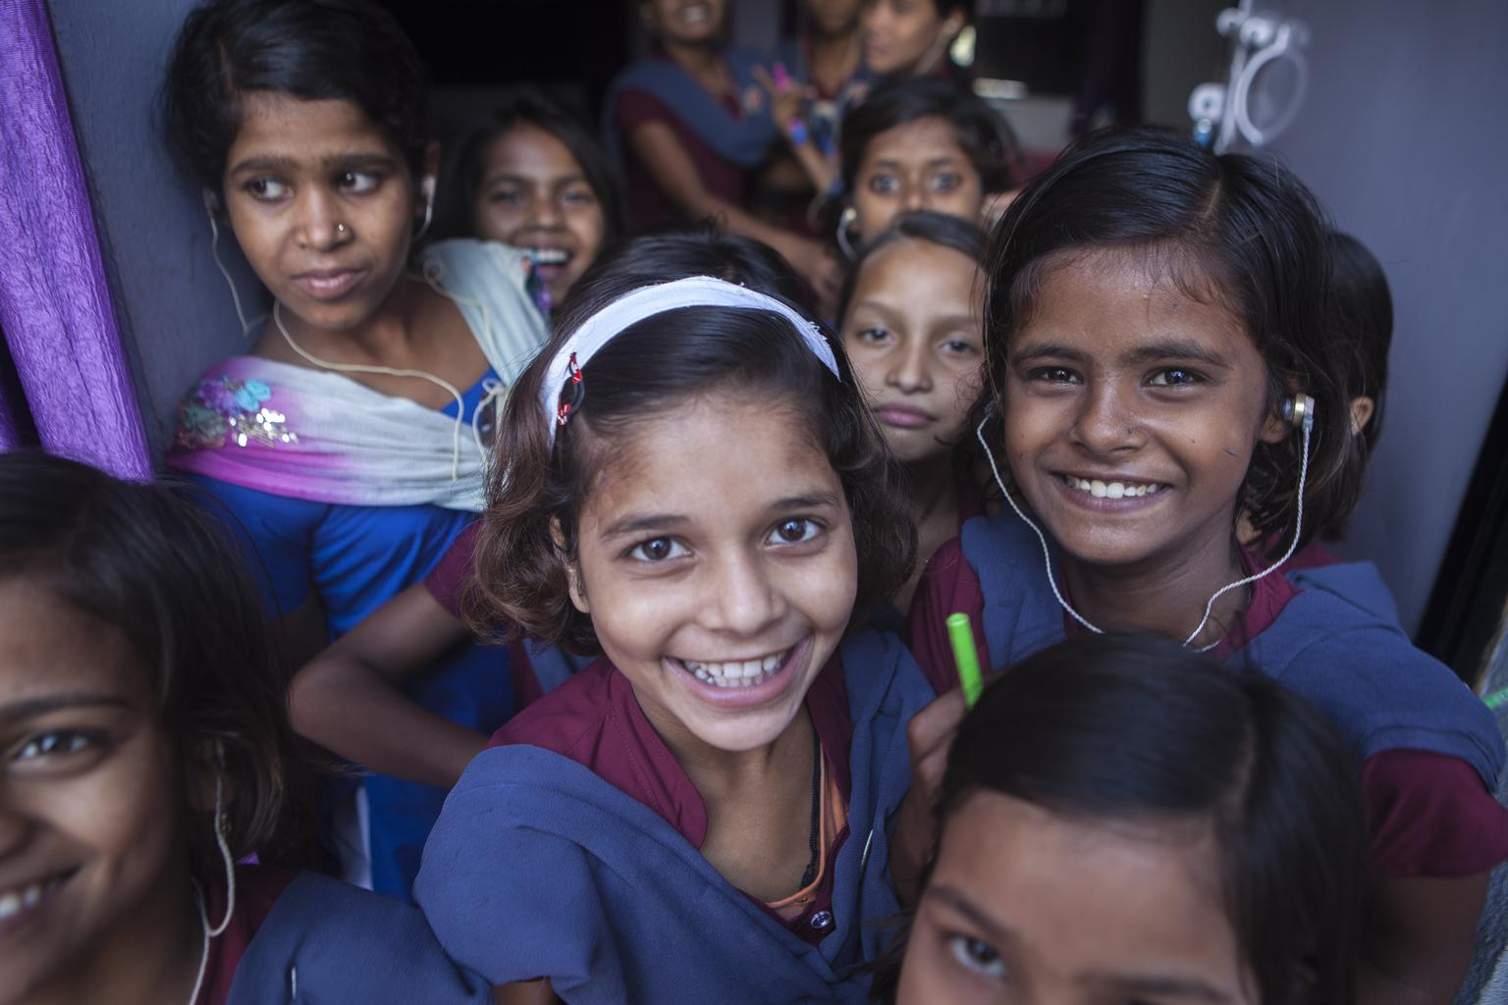

Slide 3
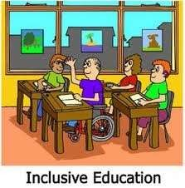
MEANING
“Inclusive Education is defined as a learning environment that promotes the full personal, academic and development professional of all learners irrespective of race, class, colour, gender, disability, sexual preference, learning styles and language.”

Slide 4
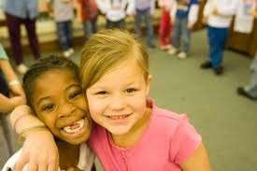
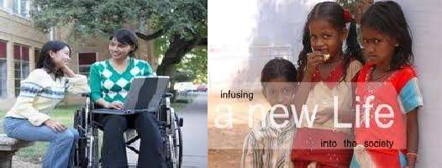
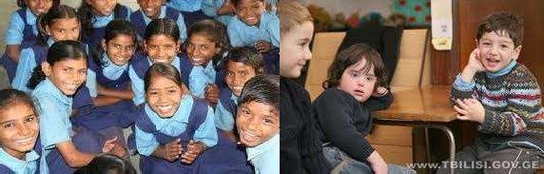
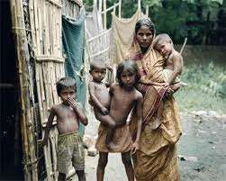
CHILDREN WHO LEARN TOGETHER, LIVE TOGETHER

Slide 5
HISTORY
District Education Programme , 1985
National Policy on Education,1986
Project Integrated Education for the Disabled, launched in 1987
Person with Disabilities Act, 1995
Integrated Education for Disabled Children Scheme launched in 1974
Sarva shiksha abhiyan, 2000
Making all Schools “Disabled Friendly” by 2020 (March 2005)

Slide 6
PRINCIPLES OF INCLUSIVE EDUCATION
No discrimination with students
Equal educational opportunity to all
School adapt to the need of student
Equal educational benefits for all students
The student’s views are listened to and taken seriously
Individual differences between students are a source of richness and diversity, and not a problem

Slide 7
PRACTICE OF INCLUSIVE EDUCATION
The practice of developing inclusive schools involves
Understanding Inclusion as a continuing process, not a one time event.
strengthening and sustaining the participation of all students, teachers, parents and community members in the work of the school.
Restructuring the cultures, policies and practices in schools to respond to the diversity of pupils within their locality.
Providing an accessible curriculum and appropriate training programmes for all (teachers and students).
Identifying and providing support for staff as well as students.

Slide 8
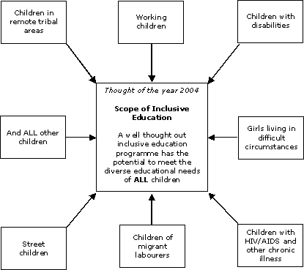

Slide 9
AIMS AND OBJECTIVES OF INCLUSIVE EDUCATION
Education for all
Protection of rights
Identification of skills
Development of social consciousness
To prepare for new challenges
Development of brotherhood
To improve quality of education

Slide 10
NEED AND IMPORTANCE
To fulfil the constitutional responsibilities
To enable children to stay with their families
For the development of healthy citizenship
For achieving the universalisation
Developing feeling of self respect
For the use of modern technology
For social equality
Self reliant

Slide 11
PROBLEMS FACED BY STUDENTS
Inferiority complex
Lack of understanding
Adjustment problem
Isolated and segregated
Lag behind
Feeling of Extra burden
Insecurity
Lack of expression
Introvert nature
Negative approach
Shyness

Slide 12



TEACHING STRATEGIES FOR INCLUSIVE EDUCATION
Co-operative learning
Peer tutoring

Slide 13
DESIGN OF CLASSROOM FOR INCLUSIVE EDUCATION
Size of class
Teaching aids
Restriction of time
Arrangement of light
Attention to physical needs
Special attention to disabled children

Slide 14
REFORMS IN CURRICULUM
Use of teaching Aids
Simple curriculum
Adequate facilities
Participation in games
Co-operative curriculum
Providing reading material
Participation in co-curricular activities
Multi-level and flexible curriculum

Slide 15


NATIONAL CURRICULUM FRAMEWORK (NFC) 2005
NORMAL CHILDREN
TEACHER
Gifted children
Normal children
Mentally challenged children
Physically challenged children
CHILDREN WITH SPECIAL NEEDS

Slide 16
BARRIERS IN INCLUSIVE EDUCATION
Negative approach
Lack of physical facilities
Lack of funds
Lack of trained teachers
Social discrimination
Emotional problems
Educational problems

Slide 17
STRATEGIES TO IMPROVE INCLUSIVE EDUCATION
Mainstreaming
Encourage students
Improve textbooks
Special training to teachers
Special care of special children
Improve methods of teaching
Provision of required resources

Slide 18
What is Inclusive Education?
It is NOT
Keeping children with disabilities out of school
Segregated special education schools
Separate classes integrated into regular schools
It IS
Including all children in mainstream schools
Exclusion
Segregation
Integration
Inclusion

Slide 19
Why is Inclusive Education important?
It’s a right
It’s a global commitment
It’s good economics
It’s good socially

Slide 20
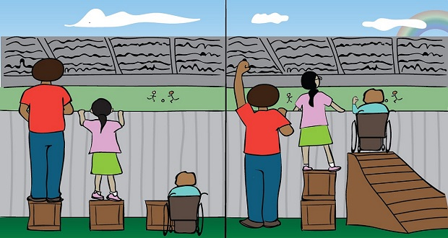
Equity Vs Equality

Slide 21
Persons with Disabilities Act ( Equal opportunity, protection of rights and full participation) 1995 (PWD Act)
Free of Cost Education
  Transport facilities to the students with disabilities
  Architectural barrier free Environment.
  The supply of books, uniforms and Aids & Appliances.
  The grant of scholarship to students with disabilities.

Slide 22
Sarva Shiksha Abhiyan, 2002 (SSA)
Sarva Shiksha Abhiyan (SSA) is the government’s millennial Education For All (EFA) umbrella programme for all education schemes, which aims to universalize elementary education, the goals are that all children aged 6-14 including the enrolment of children with disabilities.

Slide 23
Approach realization
Traditional Approach | Inclusive Approach
Education for some | Education for all
Static | Flexible
Collective teaching | Individualized Teaching
Learning in segregated areas | Learning in Integrated areas
Emphasis on teaching subject-orientated | Emphasis on learning child-centred
Diagnostic / prescriptive | Holistic
Opportunities limited by exclusion | Equalization of opportunities for all
Disability view | Curricular view
Labels children disability wise | Planning is made on ability levels and opposes all kinds of labeling

Slide 24
The Inclusive Class may have the following Children
Regular Normal School Children,
Children with Visual Impairment,
Children with Hearing Impairment,
Children with Locomotor Disability
Children with Mental Retardation.

Slide 25
Lesson planning: how will you support the needs of all learners?
Consider:- timing, - variation of activities,
- types of activities [concrete/abstract],
- reinforcement of key ideas,
- extension work - recall of previous work,
- links to future work,
- clear instructions.

Slide 26
What different teaching styles are you going to use?
Visual e.g. use photos, mind maps, maps and diagrams, pictures, film clips, digital cameras, wall displays?
Auditory e.g. use story telling, talking, effective questions, problem solving, clear sequencing, music, singing?
Kinaesthetic e.g. use movement, role play, artefacts, use the environment

Slide 27
The right to education for all: access and quality
1989 UN Convention on the Rights of the Child
1990 World Conference on Education for All (EFA) by the year 2000, Jomtien, Thailand
1993 UN Standard Rules (on Disability)
1994 Salamanca Statement – on Special Needs Education: access and quality
2000 World Education Forum, Dakar, Senegal, Review of progress on EFA Conference
2006 UN Convention on the Rights of people with Disabilities (Article 24: Education)

Slide 28
An inclusive approach to education for all
Inclusive education
Focus on disability rights
Education for All
Universal Primary
Education
Improving the quality of education

Slide 29


