Slide 1






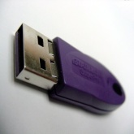
CYBER-SAFETY
NEED OF THE HOUR

Slide 2
INTRODUCTION
What is
Cyber-safety?
Consequences of inaction
Cyber-safety Actions
Cyber-safety at Home &Work
Comparing statistics of various countries
Cyber Safety threats

Slide 3
WHAT IS CYBER-SAFETY?
What is…
Cyber-safety is a common term used to describe a set of practices, measures and/or actions you can take to protect personal information and your computer from attacks.
Cyber safety is the safe and responsible use of Information and Communication Technologies (ICT).
Cyber security includes controlling physical access to the hardware, as well as protecting against harm that may come via network access, data and code injection.

Slide 4
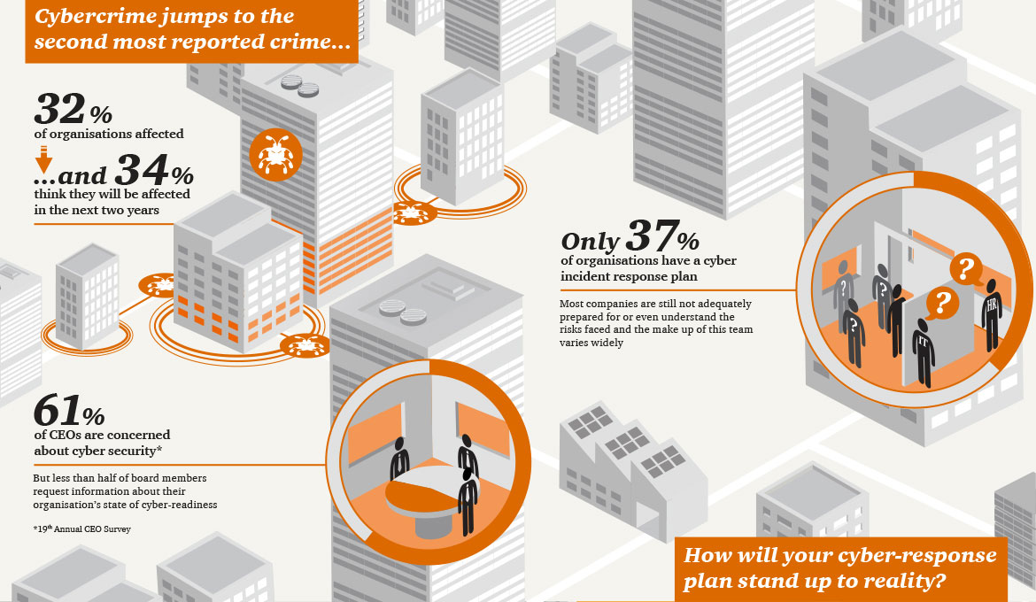

Become
an
Online
Detective

Slide 5
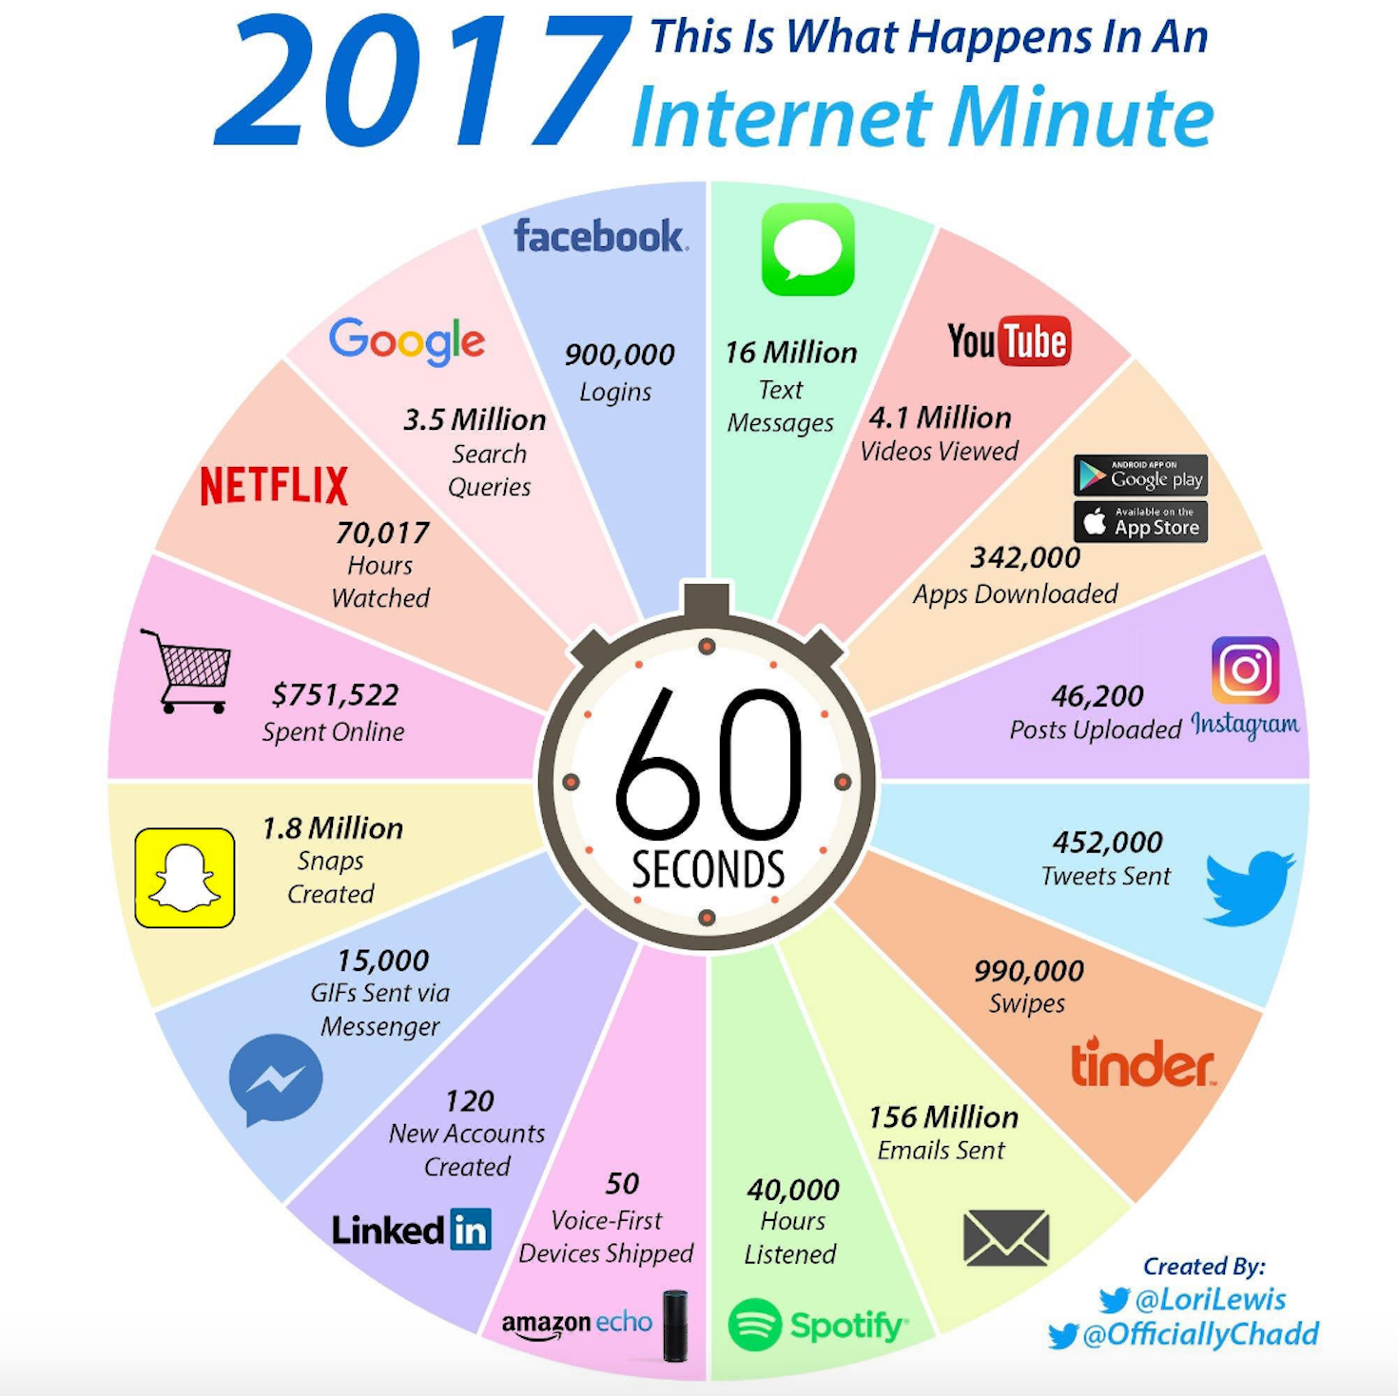

Slide 6
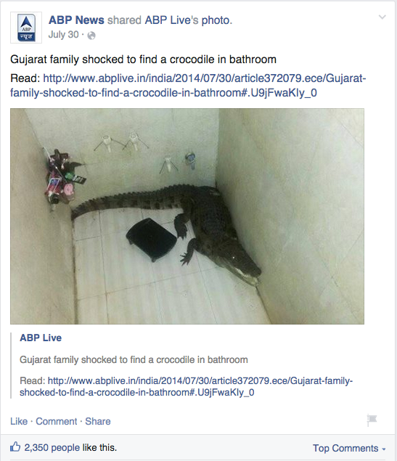
CONSEQUENCES OF INACTION
Consequences
THINK BEFORE YOU SHARE

Slide 7



Evaluating a website
Investigate the source
Who holds the copyright?
What do they want you to believe?

Slide 8
Detecting Lies
and
Staying True
Don’t be fooled by cool and professional looking websites
Always check the facts you find

Slide 9



Manage
your
digital
footprint

Slide 10


Forwarded
ONCE YOU FORWARD
ANY IMAGE OR DATA,
YOU CANNOT
REMOVE IT
FROM THE WEB,
EVEN IF YOU DELETE IT
FROM YOUR END

Slide 11

Copied & Shared
ONCE YOU
COPY OR SHARE
YOUR PRIVATE DATA,
IT BECOMES
AVAILABLE
TO A
NUMBER OF PEOPLE
ON THE WEB

Slide 12
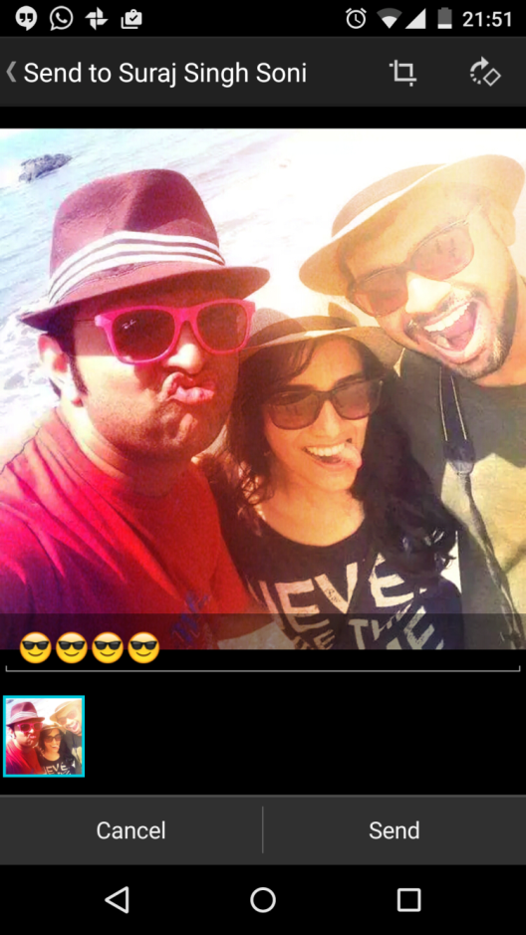


Instagram
Reddit
Blogger
Facebook
Google+
Twitter
Snapchat
?
x
=
1
SHARE

Slide 13




What you share
can take
on a life of
its own
Forwarded
Copied
Found

Slide 14
CYBER-SAFETY THREATS
Threats
First, let’s talk about some common cyber-safety threats and the problems they can cause . . .
Viruses
Viruses infect computers through email attachments and file sharing. They delete files, attack other computers, and make your computer run slowly. One infected computer can cause problems for all computers on a network.
Hackers
Hackers are people who “trespass” into your computer from a remote location. They may use your computer to send spam or viruses, host a Web site, or do other activities that cause computer malfunctions.
Identity Thieves
People who obtain unauthorized access to your personal information, such as Social Security and financial account numbers. They then use this information to commit crimes such as fraud or theft.
Spyware
Spyware is software that “piggybacks” on programs you download, gathers information about your online habits, and transmits personal information without your knowledge. It may also cause a wide range of other computer malfunctions.

Slide 15
CYBER-SAFETY ACTIONS
Actions
The following slides describe the top seven actions you can take to protect personal information and your computer.
By implementing all seven of these security measures, you will protect yourself, others, and your computer from many common threats.
In most cases, implementing each of these security measures will only take a few minutes.

Slide 16

TOP SEVEN CYBER-SAFETY ACTIONS
1. Install OS/Software Updates
2. Run Anti-virus Software
3. Prevent Identity Theft
4. Turn on Personal Firewalls
5. Avoid Spyware/Adware
6. Protect Passwords
7. Back up Important Files

Slide 17






Install OS/Software Updates
Updates-sometimes called patches-fix problems with your operating system (OS) (e.g., Windows XP, Windows Vista, Mac OS X) and software programs (e.g., Microsoft Office applications).
Most new operating systems are set to download updates by default. After updates are downloaded, you will be asked to install them. Click yes!
To download patches for your system and software, visit:
    Windows Update: http://windowsupdate.microsoft.com to get or ensure you have all the latest operating system updates only. Newer Windows systems are set to download these updates by default.
    Microsoft Update: http://www.update.microsoft.com/microsoftupdate/ to get or ensure you have all the latest OS and Microsoft Office software updates. You must sign up for this service.
    Apple: http://www.apple.com/support
    Unix: Consult documentation or online help for system update information and instructions.
Be sure to restart your computer after updates are installed so that the patches can be applied immediately.

Slide 18





Run Anti-Virus Software
To avoid computer problems caused by viruses, install and run an anti-virus program like Norton , Quickheal Virus .
Periodically, check to see if your anti-virus is up to date by opening your anti-virus program and checking the Last updated: date.
Anti-virus software removes viruses, quarantines and repairs infected files, and can help prevent future viruses.
All the systems of our school are equipped with QuickHeal Antivirus software which is being updated regularly.

Slide 19




Prevent Identity Theft
Don't give out financial account numbers, Social Security numbers, driver’s license numbers or other personal identity information unless you know exactly who's receiving it. Protect others people’s information as you would your own.
Never send personal or confidential information via email or instant messages as these can be easily intercepted.
Beware of phishing scams - a form of fraud that uses email messages that appear to be from a reputable business (often a financial institution) in an attempt to gain personal or account information. These often do not include a personal salutation. Never enter personal information into an online form you accessed via a link in an email you were not expecting. Legitimate businesses will not ask for personal information online.
Order a copy of your credit report from each of the three major credit bureaus-Equifax, Experian, and Trans Union. Reports can be ordered online at each of the bureaus’ Web sites. Make sure reports are accurate and include only those activities you have authorized.

Slide 20
Turn on Personal Firewalls
Check your computer's security settings for a built-in personal firewall. If you have one, turn it on. Microsoft Vista and Mac OSX have built-in firewalls. For more information, see:
    Mac Firewall
    (docs.info.apple.com/article.html?path=Mac/10.4/en/mh1042.html)
    Microsoft Firewall (www.microsoft.com/windowsxp/using/networking/security/winfirewall.mspx)
    Unix users should consult system documentation or online help for personal firewall instructions and/or recommendations.
Once your firewall is turned on, test your firewall for open ports that could allow in viruses and hackers. Firewall scanners like the one on http://www.auditmypc.com/firewall-test.asp simplify this process.
Firewalls act as protective barriers between computers and the internet.
Hackers search the Internet by sending out pings (calls) to random computers and wait for responses. Firewalls prevent your computer from responding to these calls.

Slide 21

Avoid Spyware/Adware
Spyware and adware take up memory and can slow down your computer or cause other problems.
Use Spybot and Ad-Aware to remove spyware/adware from your computer. UC Davis students, faculty and staff can get Spybot and Ad-Aware for free on the Internet Tools CD (available from IT Express in Shields Library).
Watch for allusions to spyware and adware in user agreements before installing free software programs.
Be wary of invitations to download software from unknown internet sources.

Slide 22
Protect Passwords
Do not share your passwords, and always make new passwords difficult to guess by avoiding dictionary words, and mixing letters, numbers and punctuation.
Do not use one of these common passwords or any variation of them: qwerty1, abc123, letmein, password1, iloveyou1, (yourname1), baseball1.
Change your passwords periodically.
When choosing a password:
  Mix upper and lower case letters
  Use a minimum of 8 characters
  Use mnemonics to help you remember a difficult password
Store passwords in a safe place. Consider using KeePass Password Safe (http://keepass.info/), Keychain (Mac) or an encrypted USB drive to store passwords. Avoid keeping passwords on a Post-it under your keyboard, on your monitor or in a drawer near your computer!

Slide 23
Weak Passwords
12345
11111
password
hello
welcome
abc123
Letme
goodtoseeu

Slide 24
Strong Passwords
8+ characters
Mix letters, numbers, & symbols
Different for every site
Use 2 Step Verification
Essential
Keep your recovery options updated

Slide 25
Strong Passwords
Let’s practice
XYZ Public School
→ 2015XYZpS!
Don’t Be Evil!
→ D0n’tBe3vil!

Slide 26



Consider your password
like your toothbrush…
NEVER SHARE IT !!!
1 in 3 teens
has
shared
a password
o0ps

Slide 27
Steps to Safety
Create strong passwords
Don’t share your password

Slide 28

Back Up Important Files
Reduce your risk of losing important files to a virus, computer crash, theft or disaster by creating back-up copies.
Keep your critical files in one place on your computer’s hard drive so you can easily create a back up copy.
Save copies of your important documents and files to a CD, online back up service, flash or USB drive, or a server.
Store your back-up media in a secure place away from your computer, in case of fire or theft.
Test your back up media periodically to make sure the files are accessible and readable.

Slide 29

True or False:
Most people never check their social network settings.

Slide 30
TRUE

Slide 31
True or False:
Over 50% of mobile phone users location tag their post.

Slide 32
TRUE

Slide 33
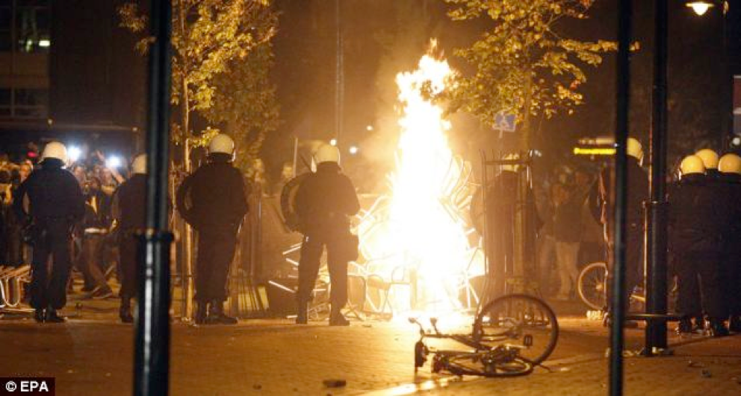
Viral party invite ends in massive rioting
REASON : HABBIT OF POSTING
EVERY STATUS & CHECK-IN
ONLINE

Slide 34
True or False:
We should use strict privacy settings to safeguard us from over-sharing.

Slide 35
TRUE

Slide 36

Cyber
Bullying

Slide 37
Cyberbullying
Sending mean messages through phone or email
Posting hurtful messages on social media or web pages
Spreading rumors online or through text
Posting embarrassing videos or photos
Stealing identity of a person
Leaving someone out of online groups
Creating a fake online profile to harass others
Spreading unauthorized videos or images

Slide 38
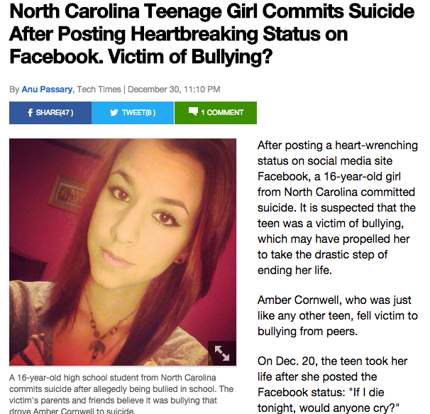
IF I DIE TONIGHT WOULD ANYONE CRY

Slide 39
Dealing with
bullies
Block and Report the Bully
Do not respond or retaliate
Reach out for HELP
Be Civil and NEVER Bully
Be an up stander , not a by stander

Slide 40

AVOID
SCAMS

Slide 41
Do you know someone who has been scammed?
What happened?
What is the purpose of a scam?
What tricks do people use to carry out a scam?
Can people get scammed on the Internet? How?

Slide 42
Identity
Theft
Phishing

Slide 43
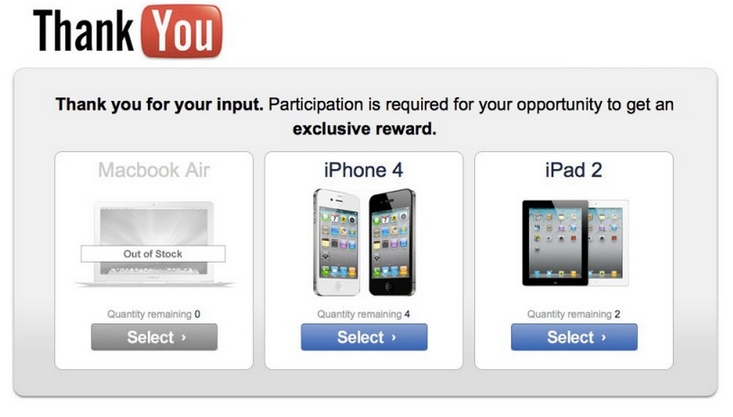

Slide 44

Name
Date & place of birth
Addresses and phone numbers
Personal identifiable Info (PIIs)
Account numbers and the companies where you hold accounts
Passwords

Slide 45
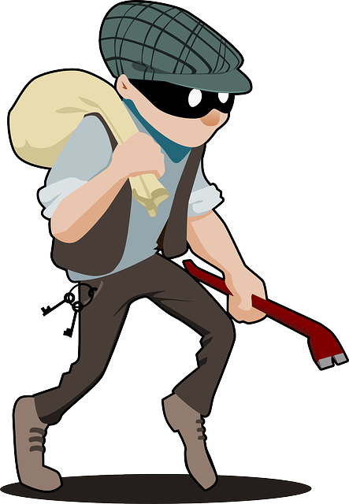
Sell your details
Impersonate you
Trick and steal from you

Slide 46
phishing
someone trying to get your personal information online
through fake sites, spam emails, and other trickery

Slide 47

sense of urgency
greeting
spelling errors
need to verify account information
alert that your account is in trouble
link in email or attachment

Slide 48
Catch The (Ph)ish

Slide 49
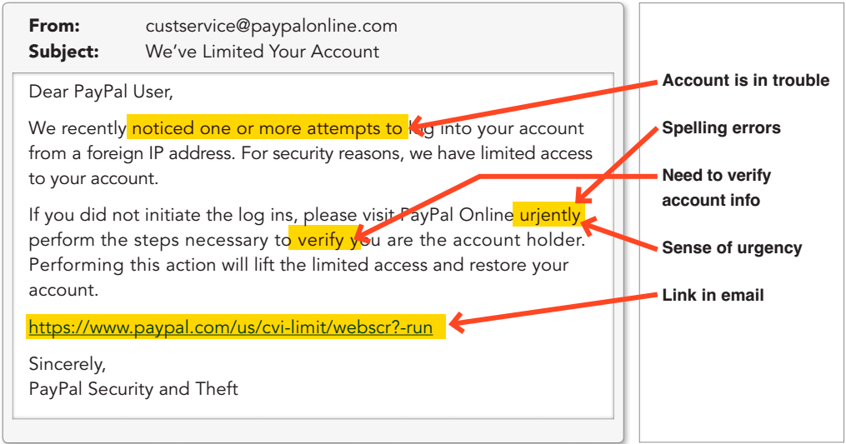

Slide 50
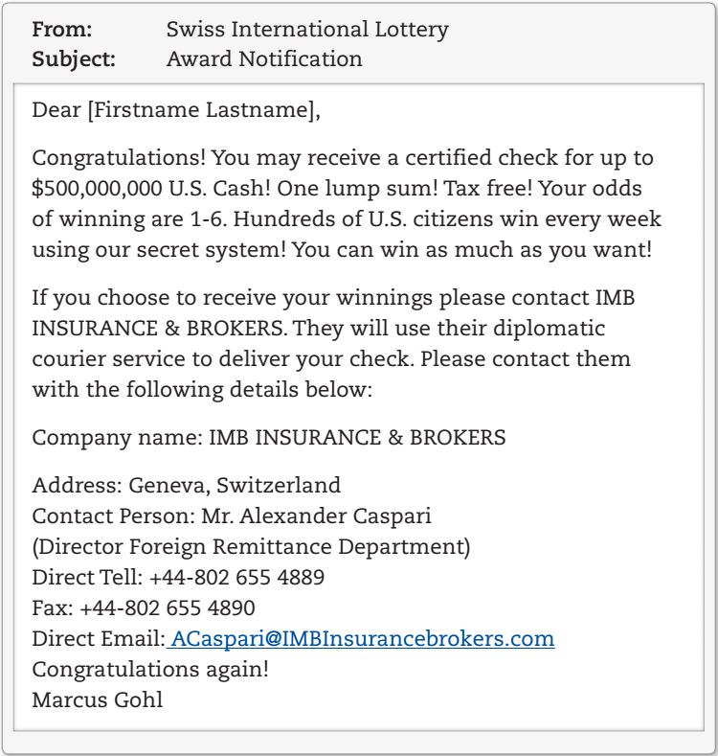

Slide 51
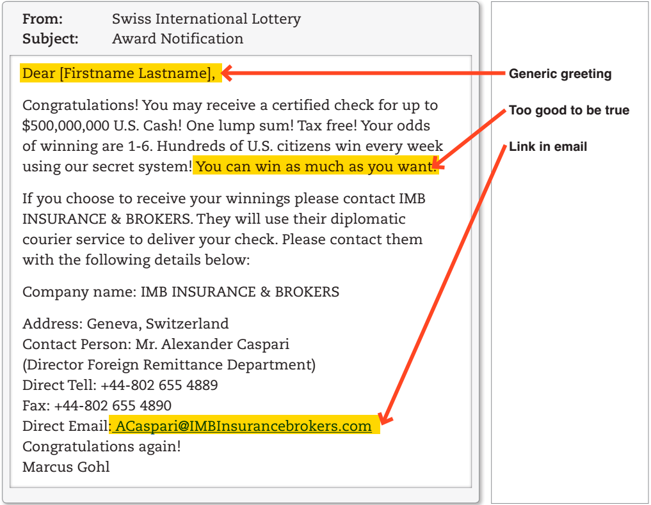

Slide 52

Steps to Safety
Don’t respond to suspicious posts or emails
Don’t respond to requests for your password
If it sounds too good to be true, it probably is NOT
When in doubt, ask a parent or guardian

Slide 53
Game Time
TRUE
FALSE

Slide 54
True or False:
It is safe to use a real person information for an online character.

Slide 55
FALSE

Slide 56
It is ok to respond to a greeting card from a “secret admirer”

Slide 57
FALSE

Slide 58
CYBER-SAFETY AT HOME
Home
Physically secure your computer by using security cables and locking doors and windows in the dorms and off-campus housing.
Avoid leaving your laptop unsupervised and in plain view in the library or coffee house, or in your car, dorm room or home.
Set up a user account and password to prevent unauthorized access to your computer files.
Do not install unnecessary programs on your computer.
Microsoft users can download the free Secunia Personal Software Inspector (https://psi.secunia.com/), which lets you scan your computer for any missing operating system or software patches and provides instructions for getting all the latest updates.

Slide 59
CYBER-SAFETY AT WORK
Work
Be sure to work with your technical support coordinator before implementing new cyber-safety measures.
Talk with your technical support coordinator about what cyber-safety measures are in place in your department.
Report to your supervisor any cyber-safety policy violations, security flaws/weaknesses you discover or any suspicious activity by unauthorized individuals in your work area.
Physically secure your computer by using security cables and locking building/office doors and windows.
Do not install unnecessary programs on your work computer.

Slide 60
SCHOOL CYBER-SAFETY SERVICES
School Services
The schools must include the following services :
Services | Software
School email virus filtering School firewall services Email attachment filtering Vulnerability scanning Intrusion prevention system | Free anti-virus software: Quickheal Anti-virus Free encryption software for PC

Slide 61
CASE STUDY :
ANALYSIS OF CYBER CRIME AND COMPARISON OF THE STATISTICS OF CYBER CRIME IN THE VARIOUS COUNTRIES
USA
INDIA
CHINA

Slide 62
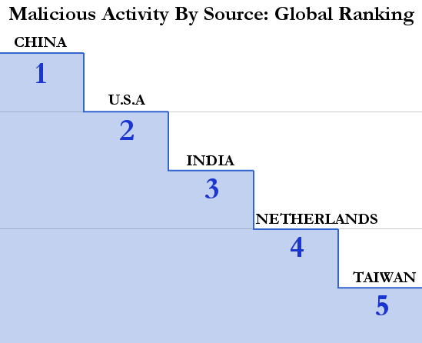
GLOBAL RANKING

Slide 63
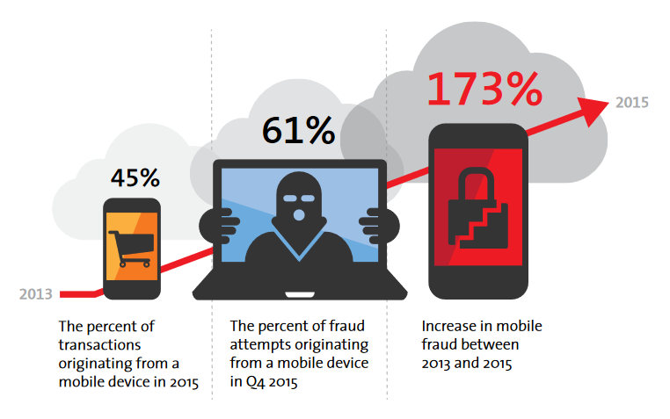

Slide 64
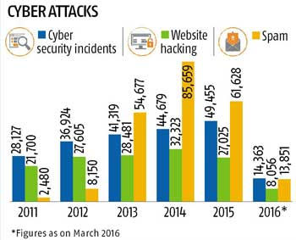
CYBER CRIME STATISTICS IN INDIA

Slide 65
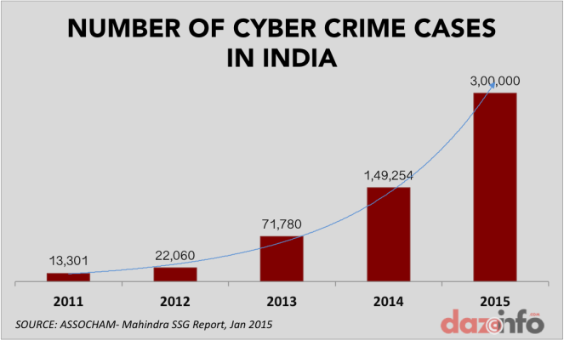
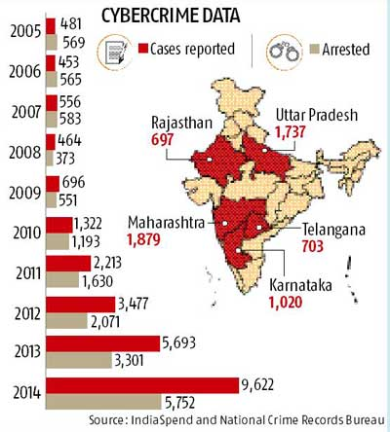

Slide 66
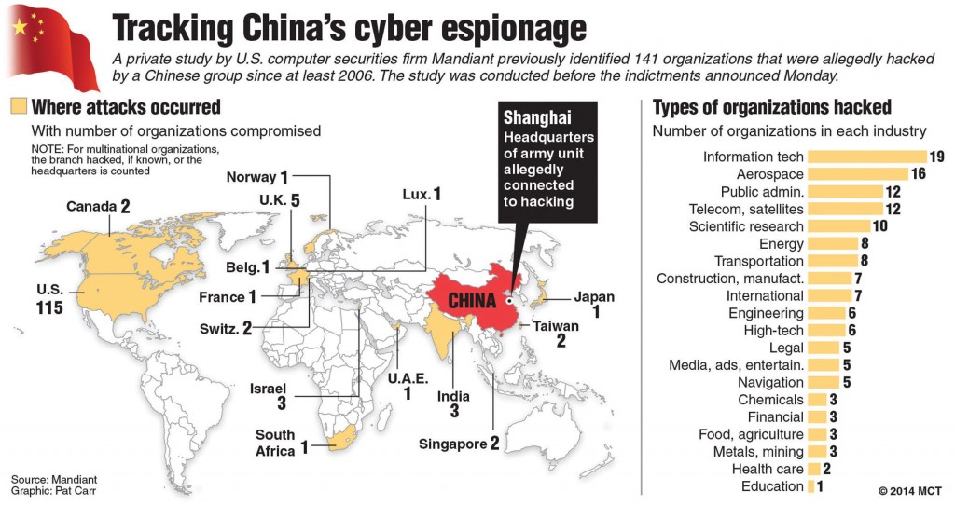
CYBER CRIME IN CHINA

Slide 67
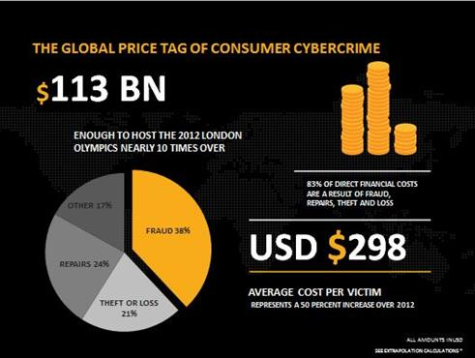
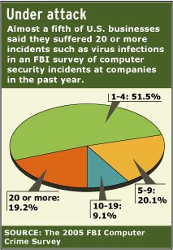
CYBER CRIME IN USA

Slide 68
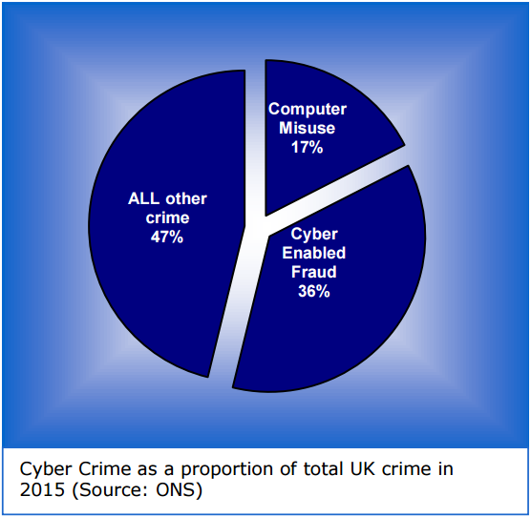
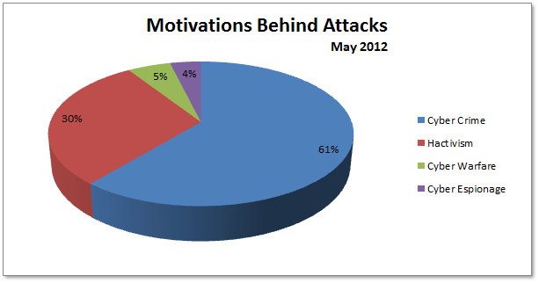

Slide 69
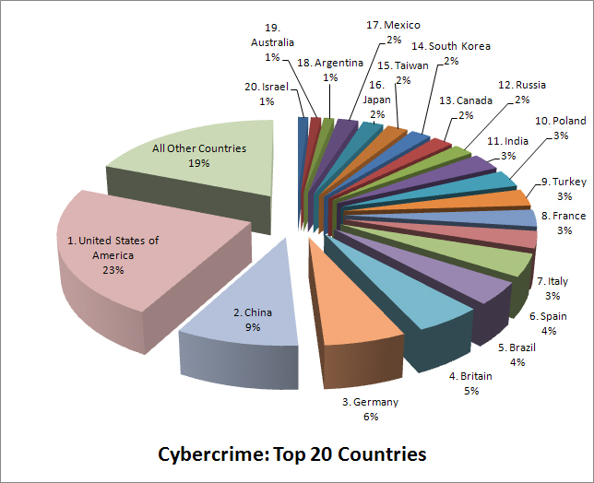
RANKING OF COUNTRIES

Slide 70
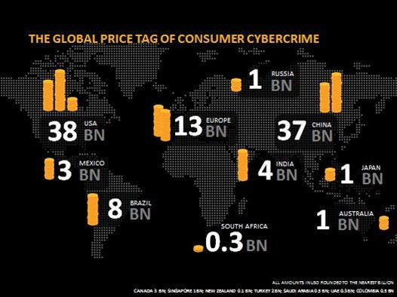
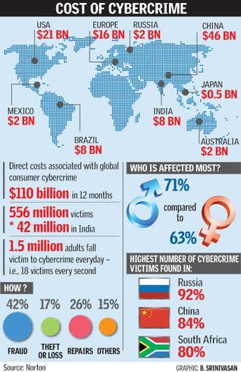
COMPARING THE COST OF CYBERCRIME

Slide 71
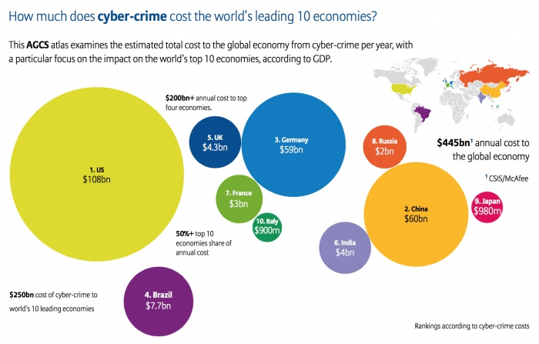

Slide 72
REFERENCES
www.cybertelecom.org/security/crimeref.htm
indianexpress.com › Technology › Tech News
https://www.statista.com › Society › Crime & Law Enforcement
www.nationmaster.com/country-info/compare/China/India/Crime

Slide 73


