Slide 1



Slide 2

Teacher’s Introduction:
JALILUR RAHMAN
Head Teacher
Purbo Dapdapia GPS, Nalchity.

Slide 3



Introduction of the lesson:
Sub: English
Class: Four
Lesson: Sagar and his family.
Lesson Unit: A(first paragraph)
Time: 40 minutes

Slide 4

Learning Outcomes:
4.2.1- enjoy and understand simple stories.
3.1.1- ask and answer Wh-questions.
10.1.1- write a short paragraph by answering
a set of questions.
10.2.1 - write a short composition about
oneself, friends, family and other objects.

Slide 5


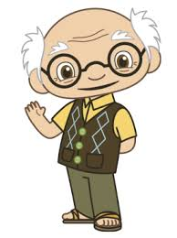



A Family

Slide 6
Do you know the boy’s name?
He is Sagar.

Slide 7
Let’s read about
Sagar and his family.

Slide 8

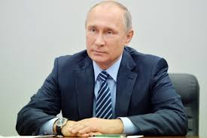
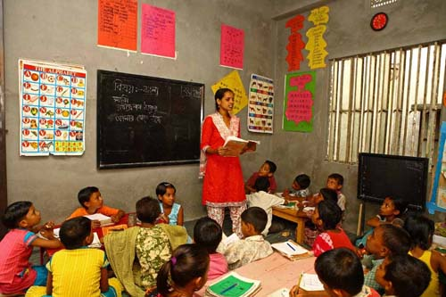
Let’s know some new words:
Housewife- woman who does the
household works.
Smart- clean, intelligent and
well-dressed person.
Teacher- Who teaches the students.

Slide 9
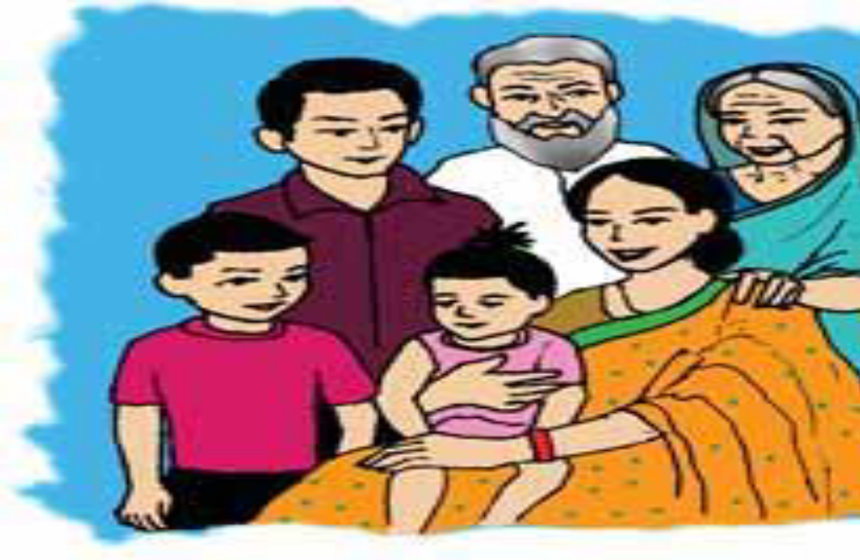

Sagar
Sagar’s family.

Slide 10
Hi! I’m Sagar. I am in class 4. I’m nine years old.
I have a little sister. Her name is Keya. She is only three years old.

Slide 11
My father is a doctor and my mother is a housewife. My grandfather was a school teacher but he doesn’t work now.

Slide 12

My grandfather helps me with my homework. He is very smart.

Slide 13
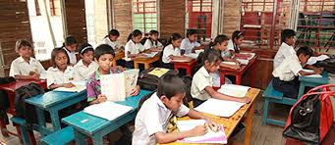
Open your book at page 30 and read the first paragraph attentively.

Slide 14
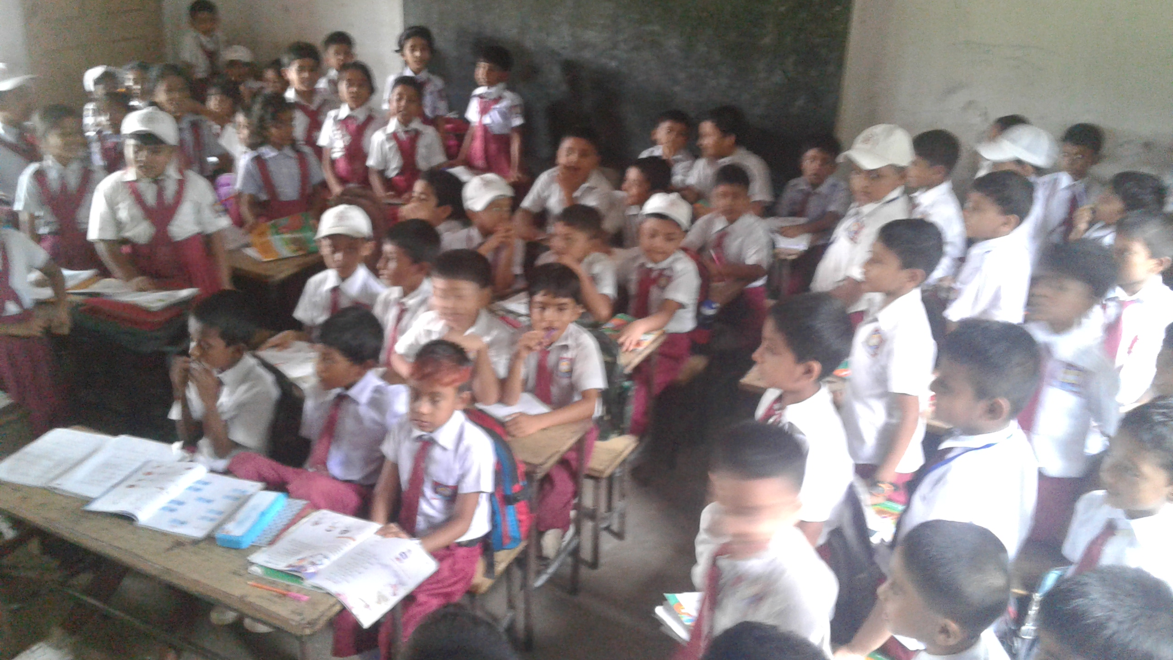
Now students, you will divide in two groups and make three questions from this passage to ask the other group.

Slide 15
Students divide in 5 groups and write the answer of the following questions by discussing with your group members.
How old is Sagar?
Ans: Sagar is nine years old.
2. What is the name of his sister?
Ans: Sagar’s sister’s name is Keya.
3. What does Sagar’s father do?
Ans: Sagar’s father is a doctor.
4. Who helps Sagar with his homework?
Ans: Sagar’s grandfather helps him with his homework.

Slide 16

Soft ball game:
We will make a ball with paper. Now throw the ball and ask a question from the slide. Who will get the ball, will give the answer and ask another one.
1.What is your name?
2. How old are you?
3. How many brothers and sisters do you have?
4.What is your father / mother?
5. What do your grandfather and grandmother do?

Slide 17

Write a short paragraph by answering a set of questions given below:
1.What is your name?
2. How old are you?
3. How many brothers and sisters do you have?
4.What is your father/mother?
5. What do your grandfather and grandmother do?
6. Who helps with your homework?

Slide 18


