Slide 1
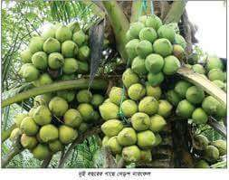
welcome

Slide 2

শিক্ষক পরিচিতি
Md Jalilur Rahman
Head Master
Purbo Dapdapia GPS, Bangladesh

Slide 3
Class:One
Sub :English
Alphabet
Lessons 4-6
Unit 2-5

Slide 4
Learning Outcomes
By the end of the lesson the students will be able
To know the letters.
To learn some new words and meaning.

Slide 5


Slide 6
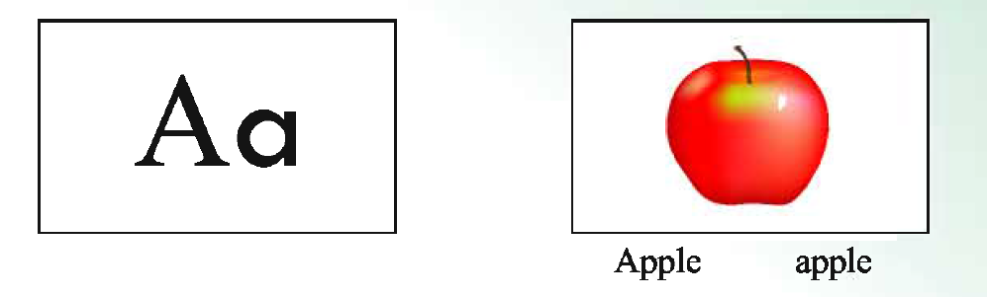
Aa

Slide 7
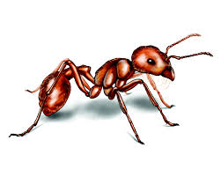
ant

Slide 8


Slide 9

Bb
ball

Slide 11
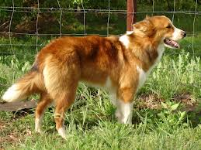
Dd
Dog

Slide 12
Write the meaning of the words
Ball Cat Dog

Slide 13
The end

