Slide 1
Consumer Market Behaviour
Humans create an interesting subject of study in relations to their buying behaviour.
They are interested in a huge variety of products
Consumers’ buying behaviour is complex but understanding it is essential to marketing management.
Consumer buying behaviour – the buying behaviour of final consumers: individuals, households who buy goods and services for personal consumption.
Consumer market – all individuals and households who buy or acquire goods and services for personal consumption.

Slide 2
Consumer Market Behaviour
Model of Consumer Behaviour
Consumers make different buying decisions and make different types of purchases every day.
For marketers, they want to know what consumers are thinking of and how to stimulate their thinking in a particular direction.
  what do consumers buy?
  Who buys?
  How they buy?
  Where they buy?
  Why they buy?
Key question: how do consumers respond to various marketing stimuli which marketers use?

Slide 3
Consumer Market Behaviour
Model of Consumer Behaviour
Market stimuli – (6 Ps): product, price, place, promotion, people, processes
Other stimuli – economic, technology, political, cultural
Buyer’s (black box) – buyer characteristics, buyer decision process
Buyer’s response:
product & service selection
brand selection
dealer choice
reseller selection
purchase timing
repurchase interval
purchase amount

Slide 4
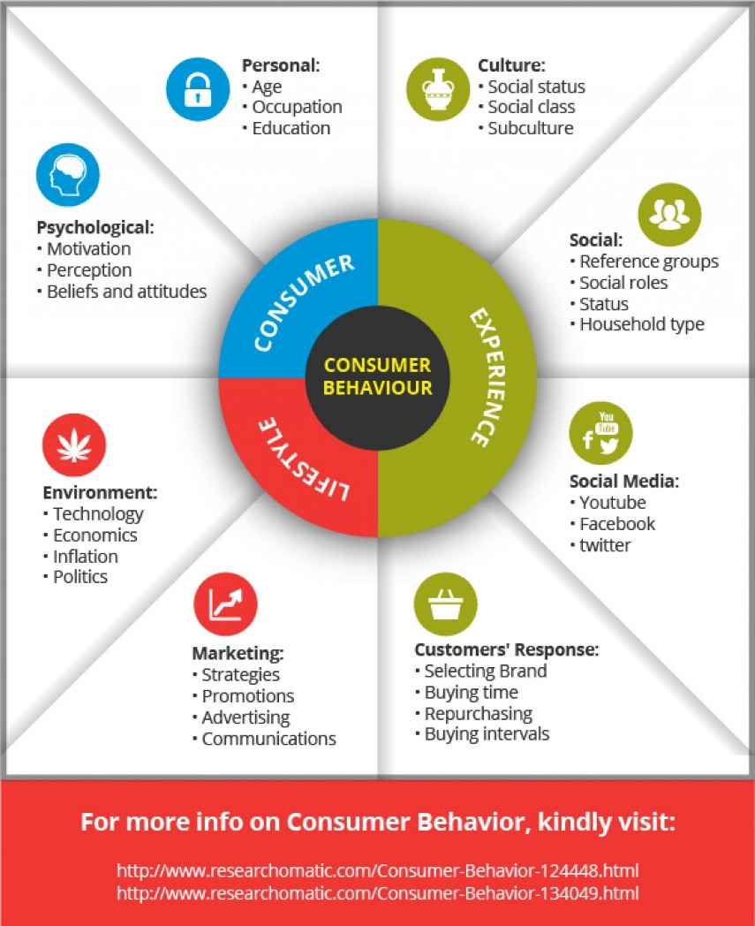
Factors Influencing Consumer Behaviour
Factors Influencing Consumer Behaviour

Slide 5
Consumer Market Behaviour
Characteristics Influencing Consumer Behaviour
2 key influences on consumer behaviour:
  Psychological
  Personal
There are also external influences:
  Cultural
  Social
Marketing influences – controllable but significant

Slide 6
Consumer Market Behaviour
Characteristics Influencing Consumer Behaviour
1 Psychological Influence – how buying choices are influenced by:
Motivation, Perception, Learning, Beliefs, Attitudes
Motivation – a need that is sufficiently pressing to direct the person to seek satisfaction of the need.
In any purchasing, what needs are being satisfied.
Perception – process by which a person select, organize, interpret information to make sense of the world (environment).
What an individual does, and how is determined by the perception of the situation they’re in.

Slide 7
Consumer Market Behaviour
Characteristics Influencing Consumer Behaviour
Perception: people are different and view the same situation differently. This is due to selective exposure, selective distortion, selective retention
The experience an individual (consumer) go through result in learning, where consumers behave differently in responding to their needs.
For marketers they can take advantage of this change in consumer behaviour by associating a strong drive using motivating cues and positive reinforcement.
They match their competitors because consumers can switch to another marketer of similar brands (generalization) or design brand to appeal to a set of drive and offer strong reinforcement to switch (discrimination).

Slide 8
Consumer Market Behaviour
Beliefs and attitude – learning contributes to one’s beliefs and attitude, which also influence their buying behaviour.
Belief – what a person thinks very strongly about (conviction), like a conviction that a Cannon camera is better than Nikon. Obviously they will buy a Cannon brand digital camera.
Attitude – one’s relatively consistent evaluation, feelings and tendencies towards an object or an idea. Consumers have an attitude towards companies or a brand. Because I believe the Cannon camera is better than Nikon, I won’t pay attention to an advertising billboard or commercial about Nikon camera.

Slide 9
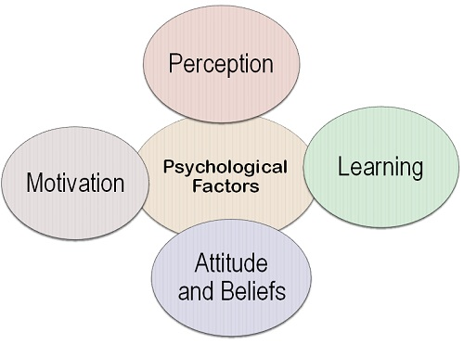
Psychological Influences
Psychological Influences

Slide 10
Consumer Market Behaviour
Personal Influences – personal characteristics that influence buying decision, such as age, life-cycle stage, occupation, education, economic situation, personality, self-concept, lifestyle.
Age and life-cycle stage – people change at various stages of their lives, so their needs, tastes, special needs also varies.
Occupation – one’s occupation affects what goods and services they bought.
Manual workers, athletes, students.
Education – one’s level of education determine their social class, they value higher standard in dress, computer usage, and access to information for their children
Economic situation – what vehicle they drive, what type of house they live in.

Slide 11
Consumer Market Behaviour
Personal Influences
Personality and self-concept – one’s personality influence buying behaviour.
Personality – the distinct psychological characteristics that leads to a rather consistent and lasting responses to their environment.
Eg. Coffee drinkers tend to be high on sociability so they carry a relaxing message, when drinking coffee.
Consumer service – people coming from the same sub-culture, social class or occupation have different lifestyles.
Life style – one’s pattern of living psychographics, such as activities they do, interests and opinion.
Psychgraphics: techniques used to measure lifestyles classification, using aio dimensions (activities, interests, opinion)

Slide 12
Consumer Market Behaviour
External Influences that consumer behaviour:
Cultural Influences – in terms of culture, different cultural groups, social class.
Culture – basic values, perceptions, wants, and behaviour learned by members of a society, from family and other important institutions.
Cultural diversity – where there is multicultural groups, there is rich variety of wants and needs. The market may be segmented ethnically, marketers also recognize that there are still many variations that marketing strategies need to focus on; eg. Gender preference, age, political affiliation, social class, religious affiliation etc.

Slide 13
Consumer Market Behaviour
Social class – relatively permanent and ordered division in a society whose members share similar values, interest and behaviour.
It creates a pecking order or social structure. India has a caste system.
In some society there is a social class of individuals born into a chiefly family.
Most middle-class Ni-Vanuatu are those who have completed university-level education.
For marketers, recognizing that consumers have wants and needs according to their social rankings.
Eg: Clothes and food they consume

Slide 14
Consumer Market Behaviour
Social Influence – consumer behaviour is determined by their household type, reference group, social roles and status.
Household type – members of a household influence buyers’ behaviour.
Family of orientation – the influence impose by the parents – and individuals acquires orientation towards religion, politics, economics, personal ambition, self-worth, love.
Family of procreation – buyers’ spouse and children are more influence. The family is priority in their purchases.
Marketers are interested in the buying behaviour of husband, wife, children in purchasing large variety of products and services.
Some roles are changing, especially with working wives.

Slide 15
Consumer Market Behaviour
Groups – have direct influence on a person’s behaviour, to which a person belongs. The group one belongs to, they are known as membership groups. They range from family, friends neighbour (primary groups), to more formal groups, such as religious groups, professional association, trade unions (secondary groups), are more formal and less interaction.
Reference group: groups that have a direct (face-to-face) or indirect influence on a person’s attitude and behaviour.
Marketers want to identify reference group for their target market.
Reference group influence people in 3 ways:
Expose people to new behaviour and lifestyles
Influence people’s attitude and self-concept (fit-in)
Generate pressure to conform, which influence choices of products and brands choices.

Slide 16
Consumer Market Behaviour
Marketers must try and find out how to reach opinion leaders in the reference group.
Opinion leaders – people in the reference group, due to their special skills, knowledge, personality, etc exert influence on others. Eg sports personality, etc.
Roles and Status – our positions in the different groups we belong to is defined by roles and status. A woman is a daughter with her parents, a wife and mother with her family, relations manager in her employment.
Roles determine what an individual does, which influences buying behaviour. Status reflects the esteem given to the individual by the society. So they consume products that reflect their roles and status.

Slide 17
Consumer Market Behaviour
Roles in the Buying Process
Who makes the buying decision and what roles each one makes?
Individuals in the buying process may be:
  Initiator – person who first comes up with the idea to buy a particular product/service.
  Influencer – person whose advice or views carry some weight leading to the buying decision.
  Decider – person who makes the buying decision, or part of it - whether to buy, what to buy, how to buy and where to buy.
  Buyer – person who makes the actual payment.
  User – person who consumes or uses the product/service.

Slide 18
Consumer Market Behaviour
Types of Buying Decision Behaviour
Consumers buying decisions varies with the type of purchases they make.
  Complex buying behaviour – in situations where consumer involvement is high and they see significant differences in the different available brands…purchase is expensive, risky, infrequent purchases or highly self-expressive. Consumer has to be familiar with the product category.
  Dissonance-reducing buying behaviour – high consumer involvement and there is few differences amongst existing brands. After purchase, buyer may experience discomfort because certain disadvantage may be avoided if another brand was bought instead. So marketer often offer buyers an after-sale communication to avoid such experiences.
  Habitual buying behaviour – there is low consumer involvement with few significant brand differences. Buyers simply rich for a brand, and continuing to do so out of habit, instead of brand loyalty.

Slide 19
Consumer Market Behaviour
Variety-seeking buying behaviour – there is low consumer involvement but buyer is aware of different existing brands. The consumer consumes a particular brand and the next purchase the same product is bought but of a different brand. The marketing strategy is to encourage habitual buying by offering different brands at lower prices, special deals, coupons, free samples etc. to consumers.
The Buyer Decision Process
There are stages which buyers go through to reach a buying decision. The five stages are: need recognition, information search, evaluation of alternatives, purchase decision, post-purchasing behaviour.
In routine purchases, consumers often skip or reverse some stages.

Slide 20
Consumer Market Behaviour
Need recognition – first stage where the consumer recognises a need or problem. The buyer senses a difference between present state and some desired state. It can become a drive and can also be triggered by an external stimuli.
Information search – buyer needs more information, depending on what products consumers need. If the need becomes urgent, the consumer may buy the satisfying product straight away.
Information enables the buyer to know about the brand and features of the product. It enables buyers to decide which brand to buy.
Evaluation of alternatives – based on information gathered, buyer makes a choice for the most preferred brand to buy.
Purchase decision – the buyer actually buys the product. However, two factors become critical here too:
  The attitude of the significant other, about the choice made of product to buy;

Slide 21
Consumer Market Behaviour
  There are unexpected situational factors: such as expected income, expected price, expected product benefits. These may change and preferences for purchases may not happen.
Post-purchase behaviour – the consumers takes further action after the purchase, based on their satisfaction or dissatisfaction. The consumers will be dissatisfied if the product attributes fall short of their expectation, and satisfied if it exceeds their expectations.
The bench-mark is based on the information they receive from various sources.
Marketers aimed at:
  Delighting customers because they become repeated customers
  Giving customers less than optimum outcome of a product they purchase and they discover the full potential and their delight
  Customers are also delighted when a supplier provides excellent back-up service.

Slide 22
Consumer Market Behaviour
The Buyer Decision Process for New Products
Buyers also make decisions about buying new products.
New Product: a good or service that is perceived by potential customers as new. The product may be around for a while. But marketers are interested in how consumers learn about the product for the first time and decide whether to adopt them.
Adoption process: mental process through which an individual passes from first learning about an innovation to final adoption.

Slide 23
Consumer Market Behaviour
Stages in the adoption process:
  Awareness: consumer becomes aware of the new product but lacks information about it.
  Interest: consumer seeks information about the new product.
  Evaluation: consumer considers whether trying the new product makes sense or not.
  Trial: consumers tries the new product on a small scale to assess its value.
  Adoption: consumer decides to make full and regular use of the new product.
Individual Differences in Innovativeness
Individuals differ in their readiness to try new products.
Early adopters – those who are early adopters.
There are 5 adopter categories: innovators, early adopters, early majority, late majority, and laggards.

Slide 24
Consumer Market Behaviour
  Innovators: consumers who are venturesome and try new ideas with some risk (2.5%)
  Early adopters: individuals who are respected by others and are opinion leaders in their communities. They adopt new ideas early but with care. (13.5%)
  Early majority: deliberately want to try new ideas before everyone else. (34%)
  Late majority: are sceptic, only accept to adopt a new innovation after majority of people have tried it. (34%)
  Laggards: are unwilling to change, are suspicious of change and only adopt innovation when it is widely accepted. (16%)
For marketers, research the characteristics of innovators and early adopters to direct their marketing effort at them.
Innovators – young, better educated, higher income, receptive to unfamiliar things, less brand-loyal, take advantage of special promotion, take risk.

Slide 25
Consumer Market Behaviour
Influence of Product Characteristics on Rate of Adoption
Some products are adopted almost overnight (internet – 50 million in 4 years)
Some products sold fast (mobile phones)
Other products take longer to be adopted (personal computers – 50 million in 16 years).
There are 5 factors which are identified as important in influencing rate of adoption:
  Relative advantage – relative ease of use of product by consumers makes the innovation more adoptable. Eg e-learning applications are now more superior to existing products such as CD-ROM, DVD or text books.
  Compatibility – where the innovation fits the value and experience of potential consumers. Educational websites are highly compatible with life style of middle-class homes.

Slide 26
Consumer Market Behaviour
  Complexity – where the innovation is complex and difficult to understand or use. This targets specific market segments. Some IT related products are in this category – Wiki application
  Divisibility – where the innovation is tried on a limited bases ie. accessories to a product can be added separately so a consumer does not have to spend more money on some unwanted parts.
  Communicability – where the result from using the innovation can be observed and described. This resulted in word-of-mouth promotion.

